Slide 1
Implementing CNNs, ViT, Transfer Learning and Fine Tuning in the detection of human skin cancer
Capstone IV, Thinkful/Chegg Skills Data Science
Chari Cortez
Notes:
Transition slides tha

Slide 2
1. Background
AI, CNNs, and breast cancer patients

Slide 3
Convolutional Neural Networks (CNNs) are the go-to for classification in image analysis
AI has markedly augmented the care of breast cancer patients
20%
2.6%
~6%
More cancers detected (than the Radiologist-only group)
Improvement in the detection of breast cancer (than a radiologist alone)
Lower rate of false positives by almost 6% in the US and 1.2% in the UK
breastcancer.org
Notes:
Renowned for its proficiency in image analysis
Demonstrated unparalleled accuracy in diagnosing medical conditions

Slide 4
2. Project Intro
CNNs, VITs, Computer-Aided Diagnosis and skin cancer patients

Slide 5
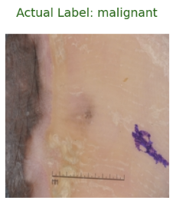
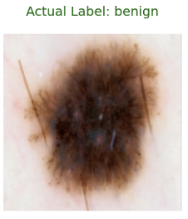
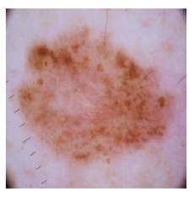
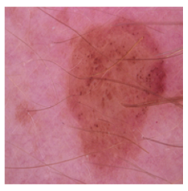
Diagnosis of skin cancer is prone to diagnostic inaccuracies
Globally, skin cancer is highly significant and widespread
Millions worldwide and consistently rising in recent years
Diagnosis depends on dermatologists’ professional knowledge and visual examination
Inherently subjective and prone to diagnostic inaccuracies
Prompt and precise diagnosis is required for timely treatment and enhancing patient outcomes
Sharma, Y.K. et al. Sci Rep 14, 4299 (2024)
Notes:
Combine background intro slides to 2 slides instead of 3

Slide 6
Computer-Aided Diagnosis (CAD) frameworks significantly improved medical dermatology
Urgent medical need for more accurate and automated mechanisms for identifying skin cancer
Avoid subjectivity and changes in precision
CNNs & Vision Transformers (ViTs) have shown remarkable promise for improving the accuracy of skin cancer recognition
Deep learning and optimization methodologies to develop enhanced techniques in skin cancer diagnosis
Transfer Learning
Fine-Tuning
Sharma, Y.K. et al. Sci Rep 14, 4299 (2024)

Slide 7
3. Project
Implementing CNNs, ViT, Transfer Learning and Fine Tuning in the detection of human skin cancer

Slide 8
Deep learning and optimization methodologies to enhance CAD of skin cancer
Deep Learning
Performance
Optimization
Binary Classification Task
CNN
ResNet-50 (Transfer Learning)
ViTForImageClassification (Transfer Learning)
Accuracy
Loss
Precision
Recall
F1/F-beta score
ROC (class balanced)
Precision-Recall (class imbalanced)
Fine-Tuning prioritizing Malignant Recall
Final layer/layers
Hyperparameters
Generalizability
Crash course in PyTorch
aka “ConTorching” ☺

Slide 9
3.1 Project Data
Processed pictures of moles from the International Skin Imaging Collaboration (ISIC) Archive + data augmentation

Slide 10
Processed pictures of moles from the ISIC Archive
ISIC
Labeled images
Promote standards in skin imaging
Gather & share dermatologic images
Engage Clinicians & CV Researchers
Train (2637 samples)
Test (660 samples)
224 x 224 of two types of moles
Malignant vs Benign
Not uniform
Class balanced
Train: 1200 | 1437
Test: 300 | 360
Some images include extra-tumoral elements
Affected extremity
Ruler or scalar element
Kaggle | Skin Cancer: Malignant vs Benign

Slide 11
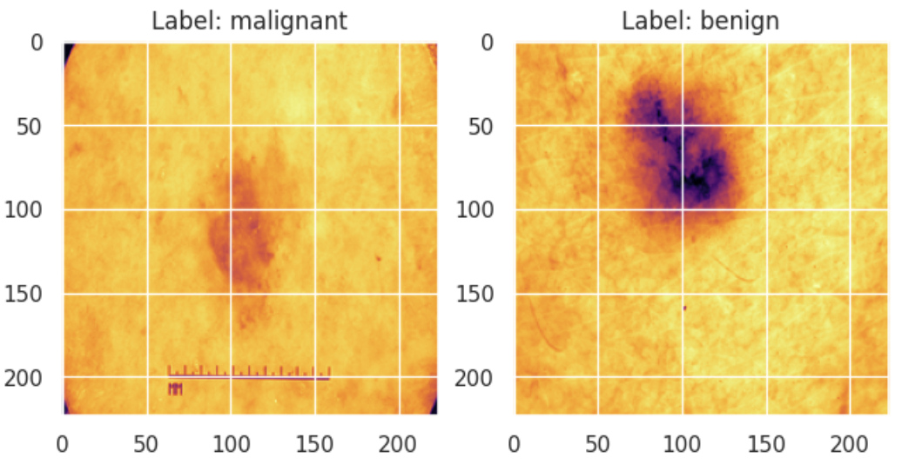
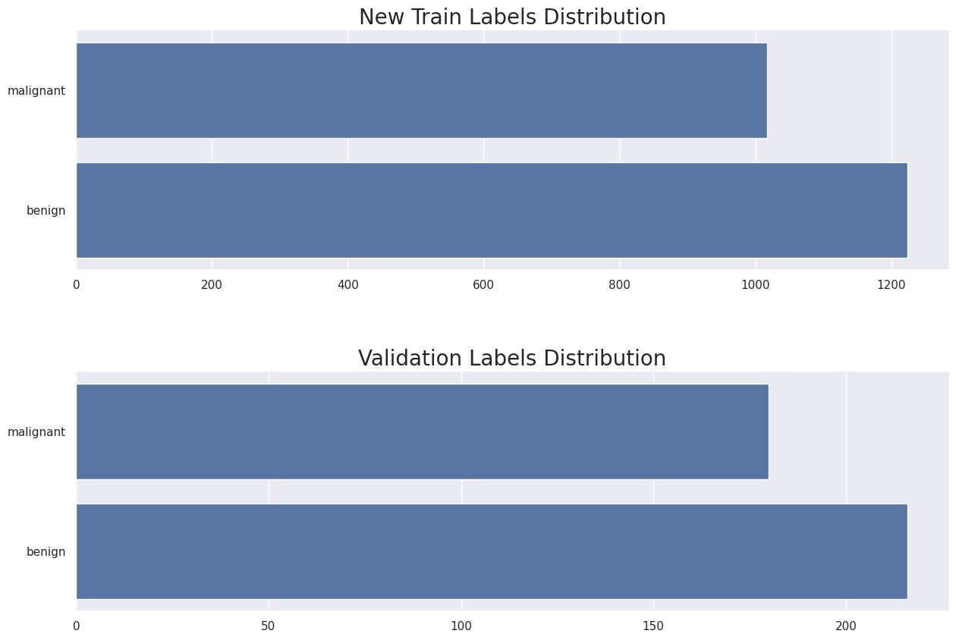
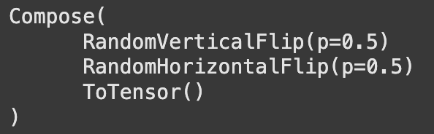
Train & Val split + data augmentations
Train (new; 80%)
Train
Transformations/
Augmentations
Validation (20%)
&
Test
Kaggle | Skin Cancer: Malignant vs Benign

Slide 12
3.2 CNN Model
Establishing baseline performance metrics

Slide 13
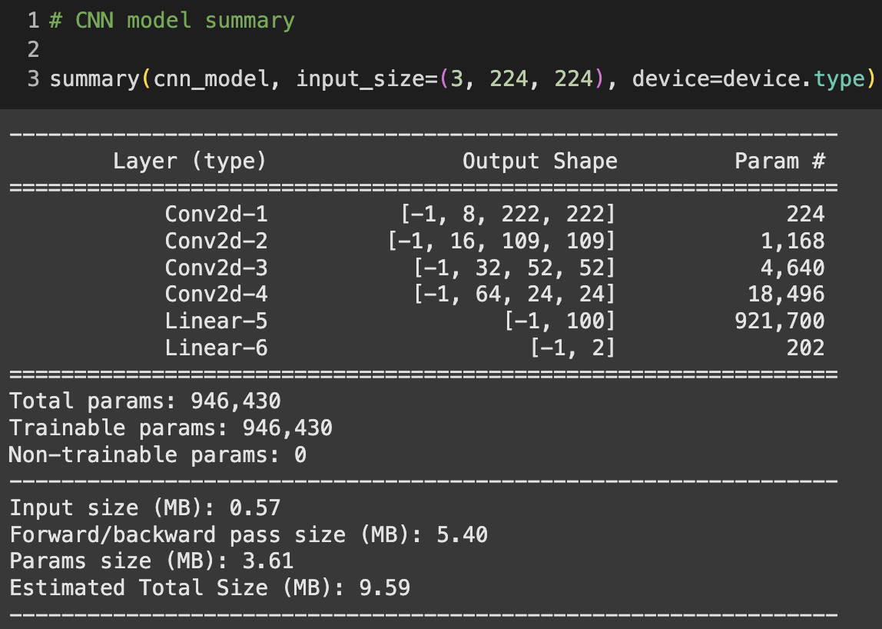
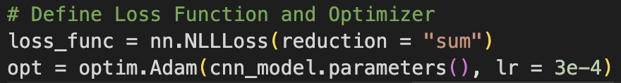
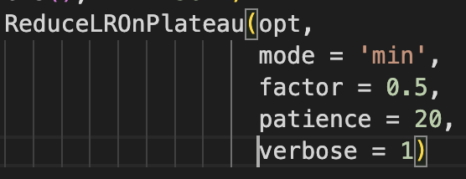
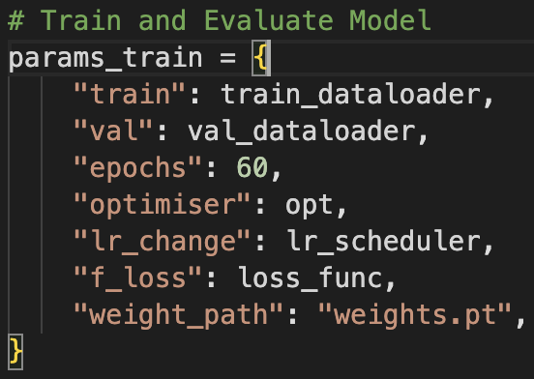
CNN model for human skin tumor classification
Kaggle | Brain Tumor Detection by CNN (PyTorch)

Slide 14
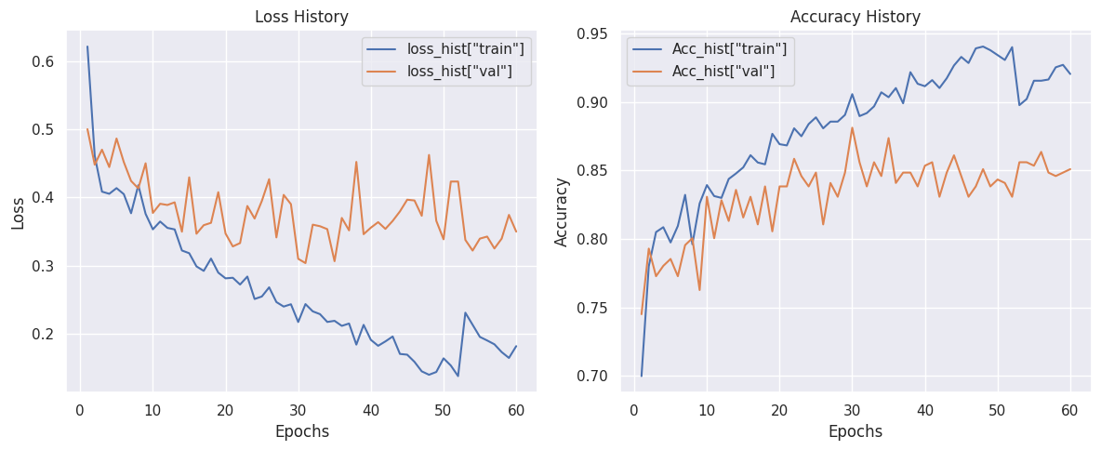
CNN model is converging and learning well

Slide 15
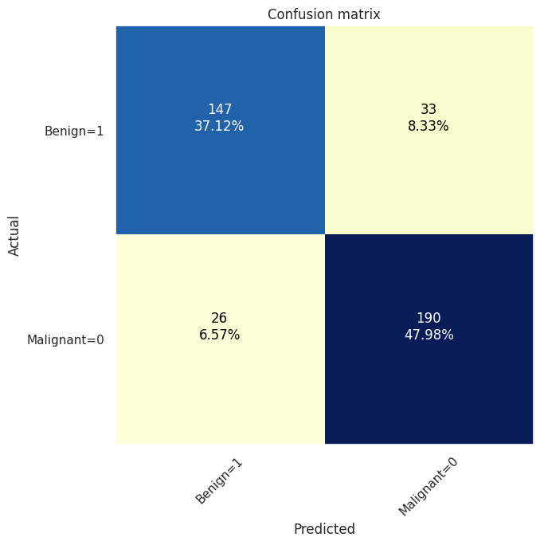
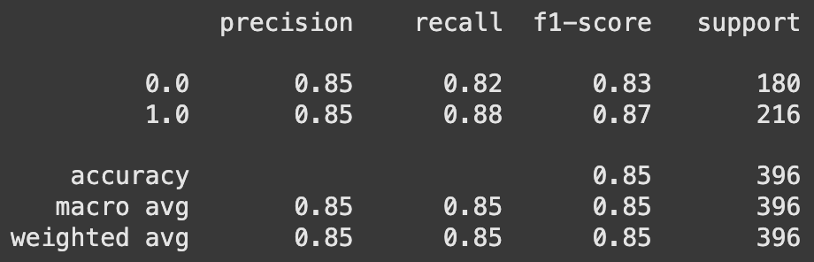
Establishing baseline performance metrics

Slide 16
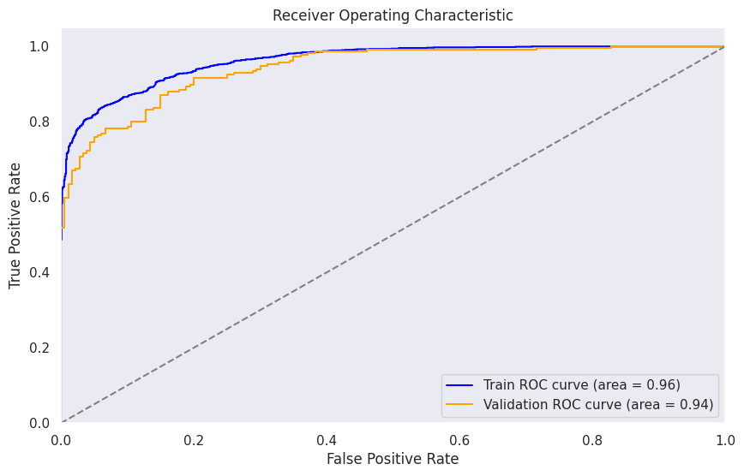
CNN ROC curves are in the ideal spot

Slide 17
3.3 ResNet Model
Transfer Learning; from Hugging Face Computer Vision course Transformers library

Slide 18
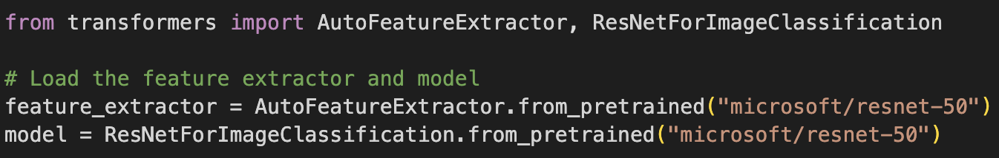
Pre-trained ResNet with an image classification head using transformers library
→ Utilized the same Loss function, Optimizer, Learning Rate, Learning Rate Scheduler, and Number of epochs used in CNN
Hugging Face Computer Vision Course -- ResNet (Residual Network)

Slide 19
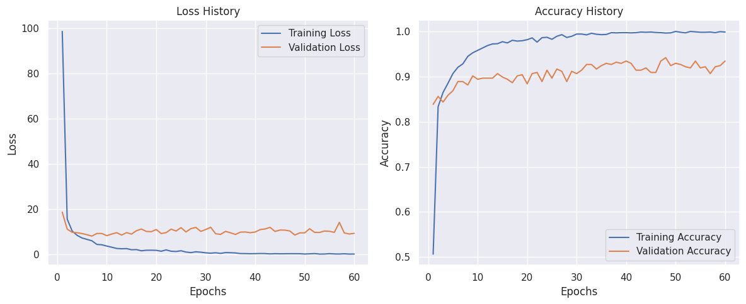
Validation data shows model is learning and performing well

Slide 20
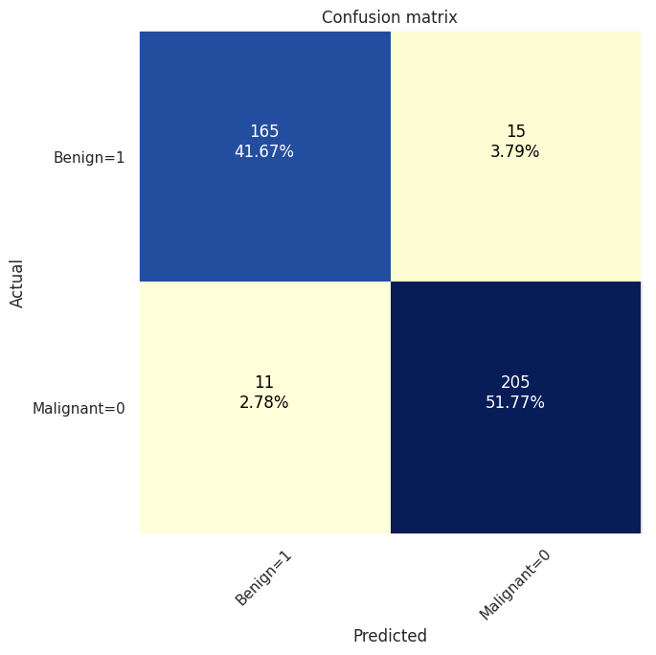
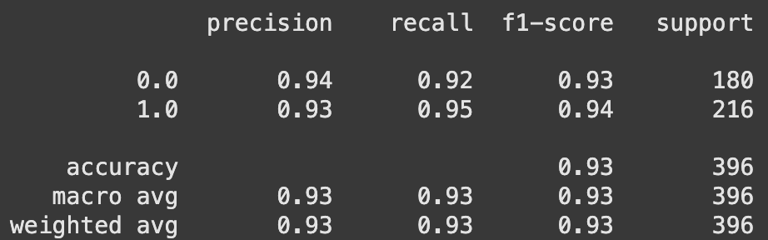
ResNet has excellent performance metrics and less False Negatives

Slide 21
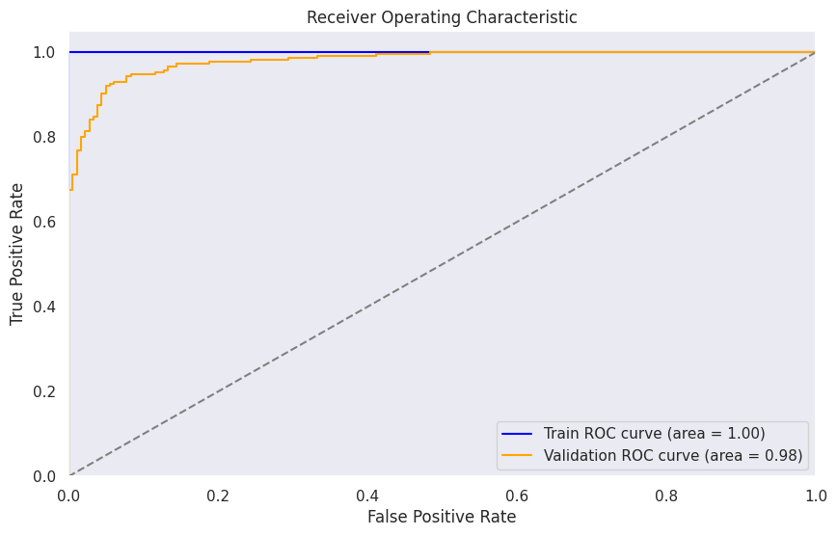
ResNet ROC curves are in the ideal spot with minimal overfitting

Slide 22
3.4 ViT Model
Transfer Learning; from Weights & Biases (W&B) AI developer platform

Slide 23
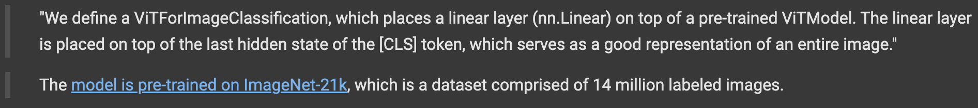
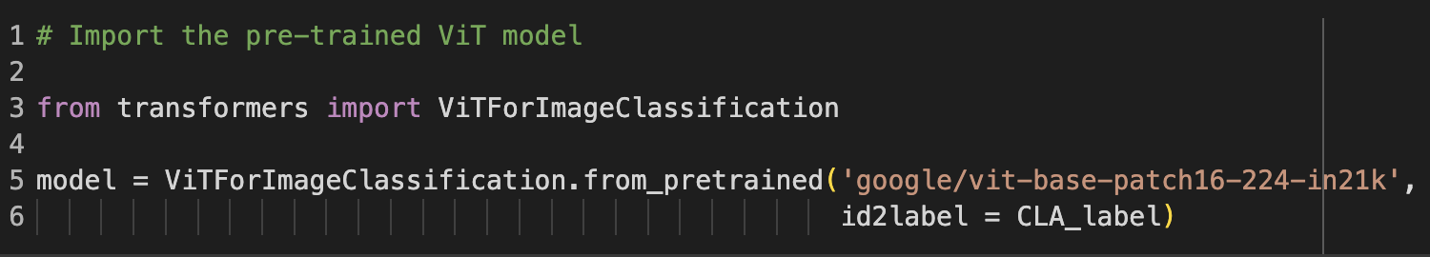
Pre-trained ViT model with a linear layer on top
Utilized the same Learning Rate Scheduler and Number of epochs used in CNN & ResNet
Kaggle | Brain Tumor Detection Vision Transformer

Slide 24
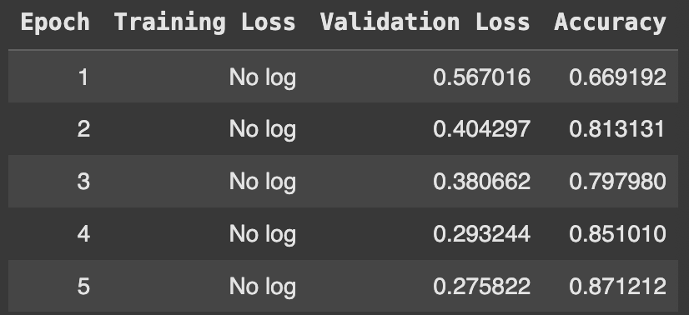
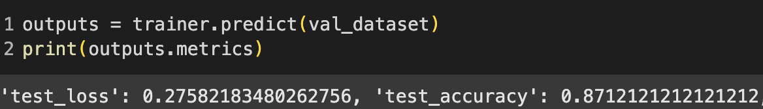
ViT is converging and learning, but has lowest accuracy

Slide 25
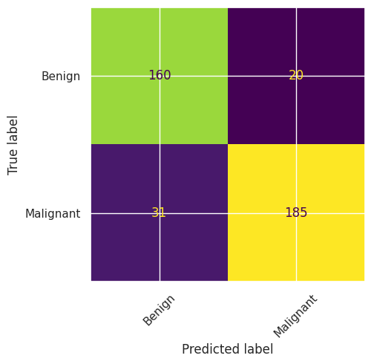
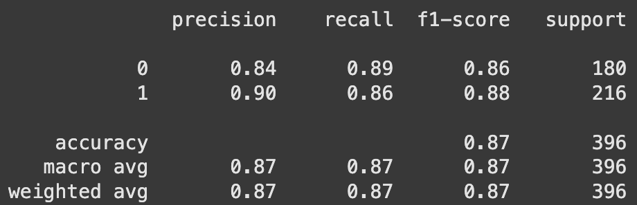
ViT performance metrics are similar to those of baseline CNN ; most FNs

Slide 26
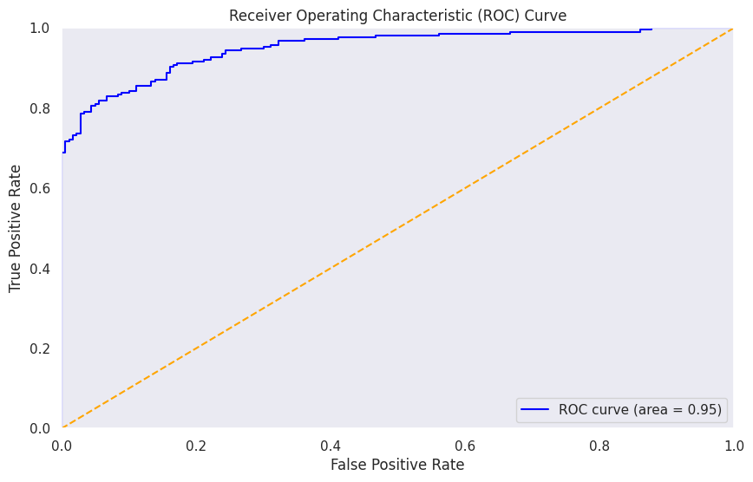
ViT Validation ROC curve is in the ideal spot

Slide 27
3.5 Model comparison summary
Selected the best-performing model for Fine Tuning

Slide 28
ResNet is the model with the best performance metrics
Highest accuracy score
Highest Malignant Recall and F1 Scores
Least False Negatives (False Malignant)
Highest ROC
Selected ResNet for Fine-Tuning

Slide 29
4. Fine Tuning ResNet hyperparameters
Prioritizing Accuracy and Malignant Recall | F1 score

Slide 30
Fine-Tuning hyperparameters
 | Number of epochs | Patience | Learning Rate
Why it’s important | No. of times that the model will work through the entire training dataset | No. of times the model keeps going after it stops learning | Determines how fast or slow we move towards optimal weights
Optimal | Reasonable training time; not computationally wasteful | Robust/invariant; not overfitting; generalizes well | Distinguishes important features; converges; reasonable training time
Decreased from → to | 60 → 15 | 20 → 8 | 3e-4 → 5e-10

Slide 31
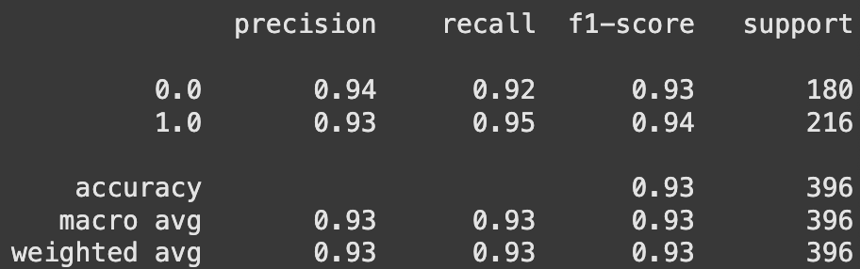

Fine-Tuning hyperparameters maintained Accuracy but increased False Negatives
Malignant Recall decreased from 0.94 to 0.92
False Malignant increased from 11 to 16

Slide 32
5. ResNet Validation and Testing
Generalization—how does the model perform on the Test dataset?

Slide 33
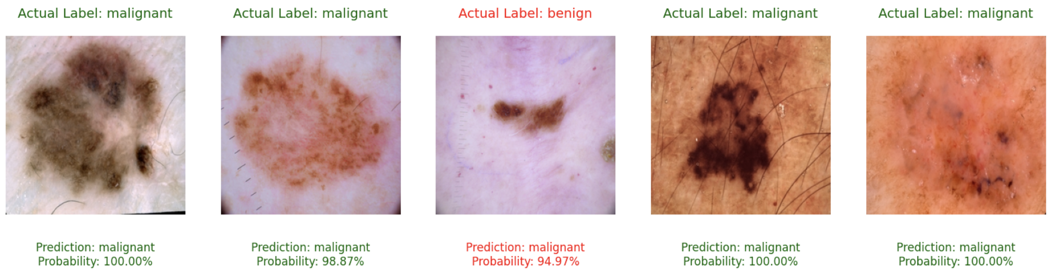
ResNet generalizes well to new, unseen data
22/25
✅
 |  | Malignant |  |  | Benign
 | Accuracy | Precision | Recall | F1-Score | Precision | Recall | F1-Score
Train | 0.93 | 0.94 | 0.94 | 0.93 | 0.93 | 0.95 | 0.94
Test | 0.88 | 0.90 | 0.83 | 0.86 | 0.87 | 0.93 | 0.90

Slide 34
6. Important Takeaways
Successfully combined deep learning and optimization methodologies to enhance CAD of skin cancer

Slide 35
A ResNet skin tumor classification model with excellent performance metrics and generalization
High Accuracy on Test
Maintained high Accuracy of 88% on Test data (new, unseen data)
Successful training
Slight differences show that model learned important features successfully and is not severely overfitting
Generalizes well across both classes
Slight differences are seen in both classes within Test and Train datasets
Excellent performance metrics and generalization underscore utility in real-world application
Real-world applicability

Slide 36
Thank you

Slide 37
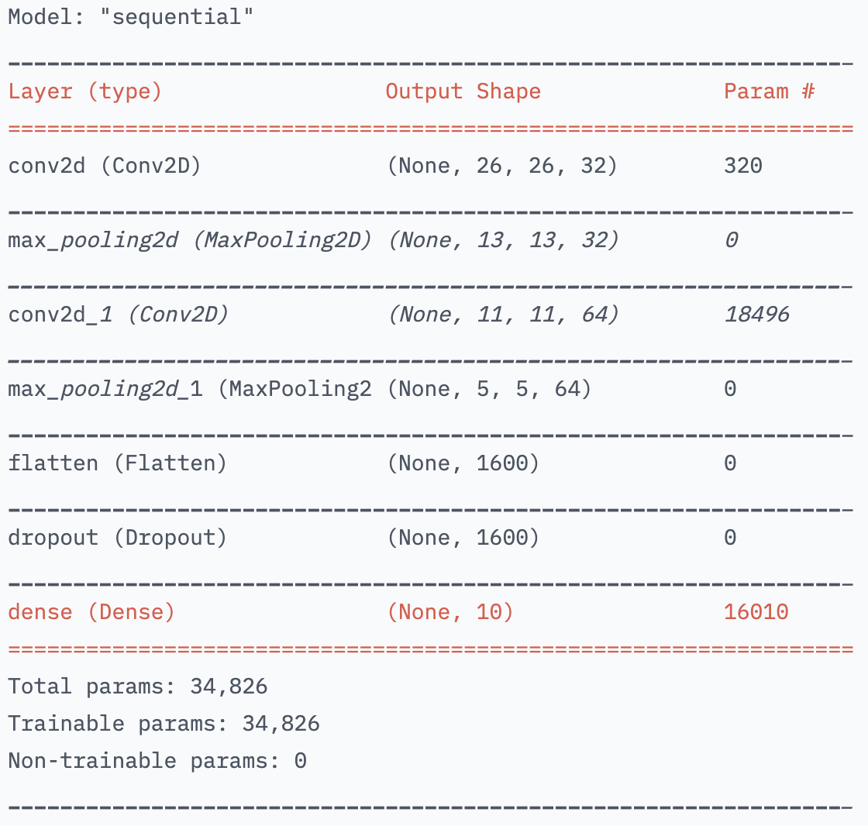
“Convolution is an operation used to extract features from data”
CNNs start with an input layer and a convolutional layer
After convolutional layers, a max pooling layer reduces the number of parameters stored and make the model robust to changes
Then the feature maps are concatenated together and flattened
Dropout is used to drop a portion of parameters (avoid overfitting)
The final form of weights go through a dense layer (where classification and backpropagation take place)
The point of training CNNs is to get the optimal kernels, which are found using backpropagation
Hugging Face Computer Vision Course
Notes:
How does backpropagation work here?
Want to optimize for the best kernel values here = our weights
In the end, want the classifier to figure out the relationship
between pixel values, kernels, and classes
Thus we have a very long flattened array consisting of elements that are pooled and activated versions of pixels convolved with initial weights (the kernel elements)
We update those weights such that classification decisions can be made
i.e., “which kernels should I apply to make a distinction between cat and dog in a photo?”

Slide 38
Vision Transformers (ViTs) have started overcoming the performance of CNNs
CNNs
ViTs
Have Inductive Biases:
Translational equivariance
Locality
Features are extracted hierarchically
Do not have Inductive Biases
Based on Transformer architecture (originally designed for NLP)
“Utilize self-attention mechanisms to capture global dependencies and relations between image patches directly”
Starting at a single pixel and zooming out
Transformer slowly brings the whole fuzzy image into focus
edge ai + vision ALLIANCE
Notes:
Translational Equivariance: an object can appear anywhere in the image, and CNNs can detect its features.
Locality: pixels in an image interact mainly with its surrounding pixels to form features.
CNN approach: like starting at a single pixel and zooming out
ViT: a Transformer slowly brings the whole fuzzy image into focus

